Slide 1
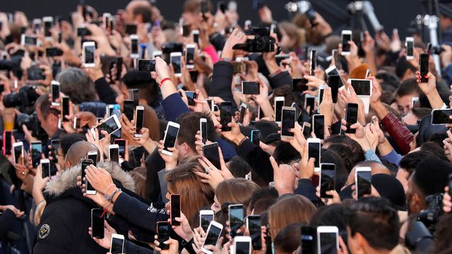
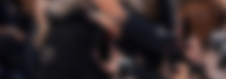
Mobile Device Usage
and User Behavior
By Kaohsiung Dlamini

Slide 2
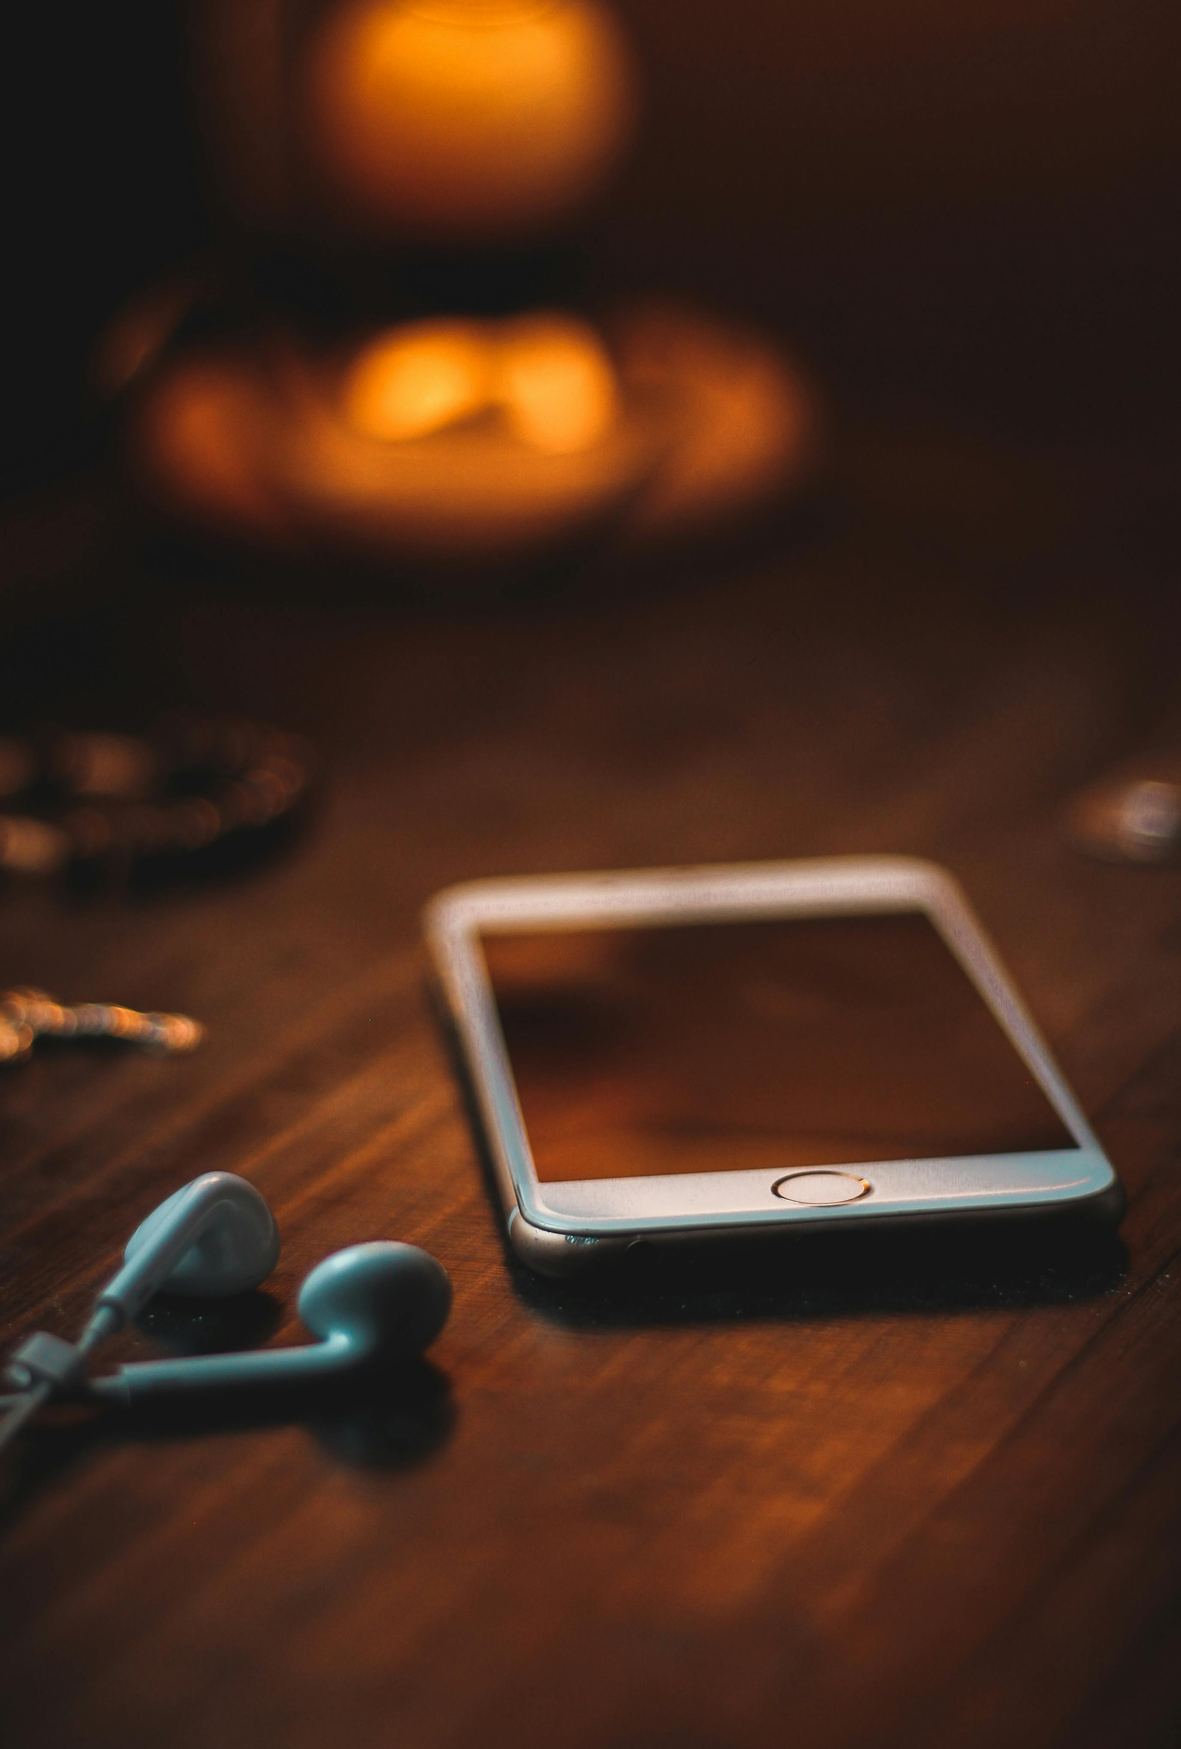
Project
Building a predictive model for Operating systems based on certain charateristics.
Dataset:
700 phone users
Analysis on 5 different models
Demographic Data: such as age, gender.
Phone Usage: Screen time, data usage, battery drain,app usage.

Slide 3
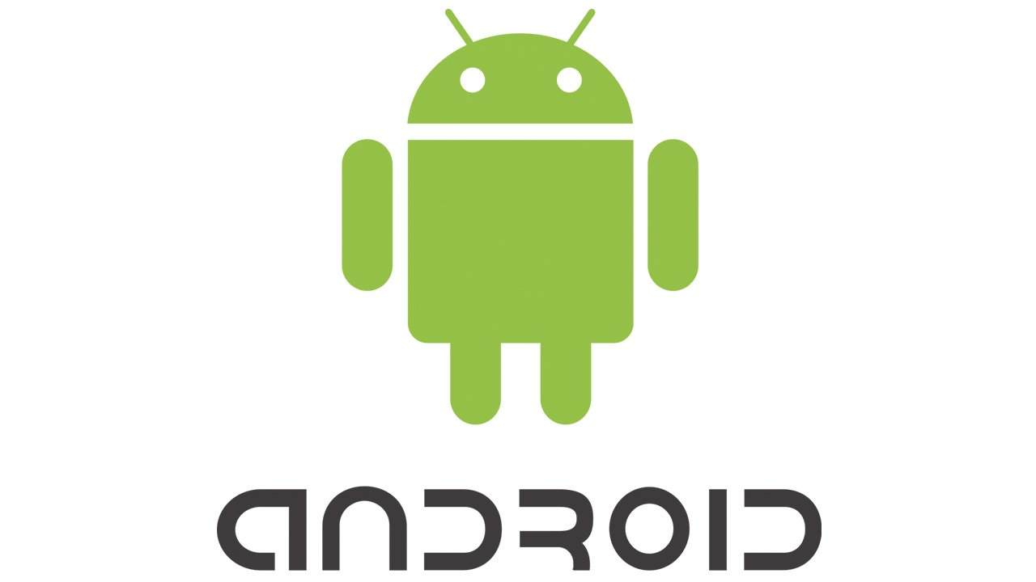
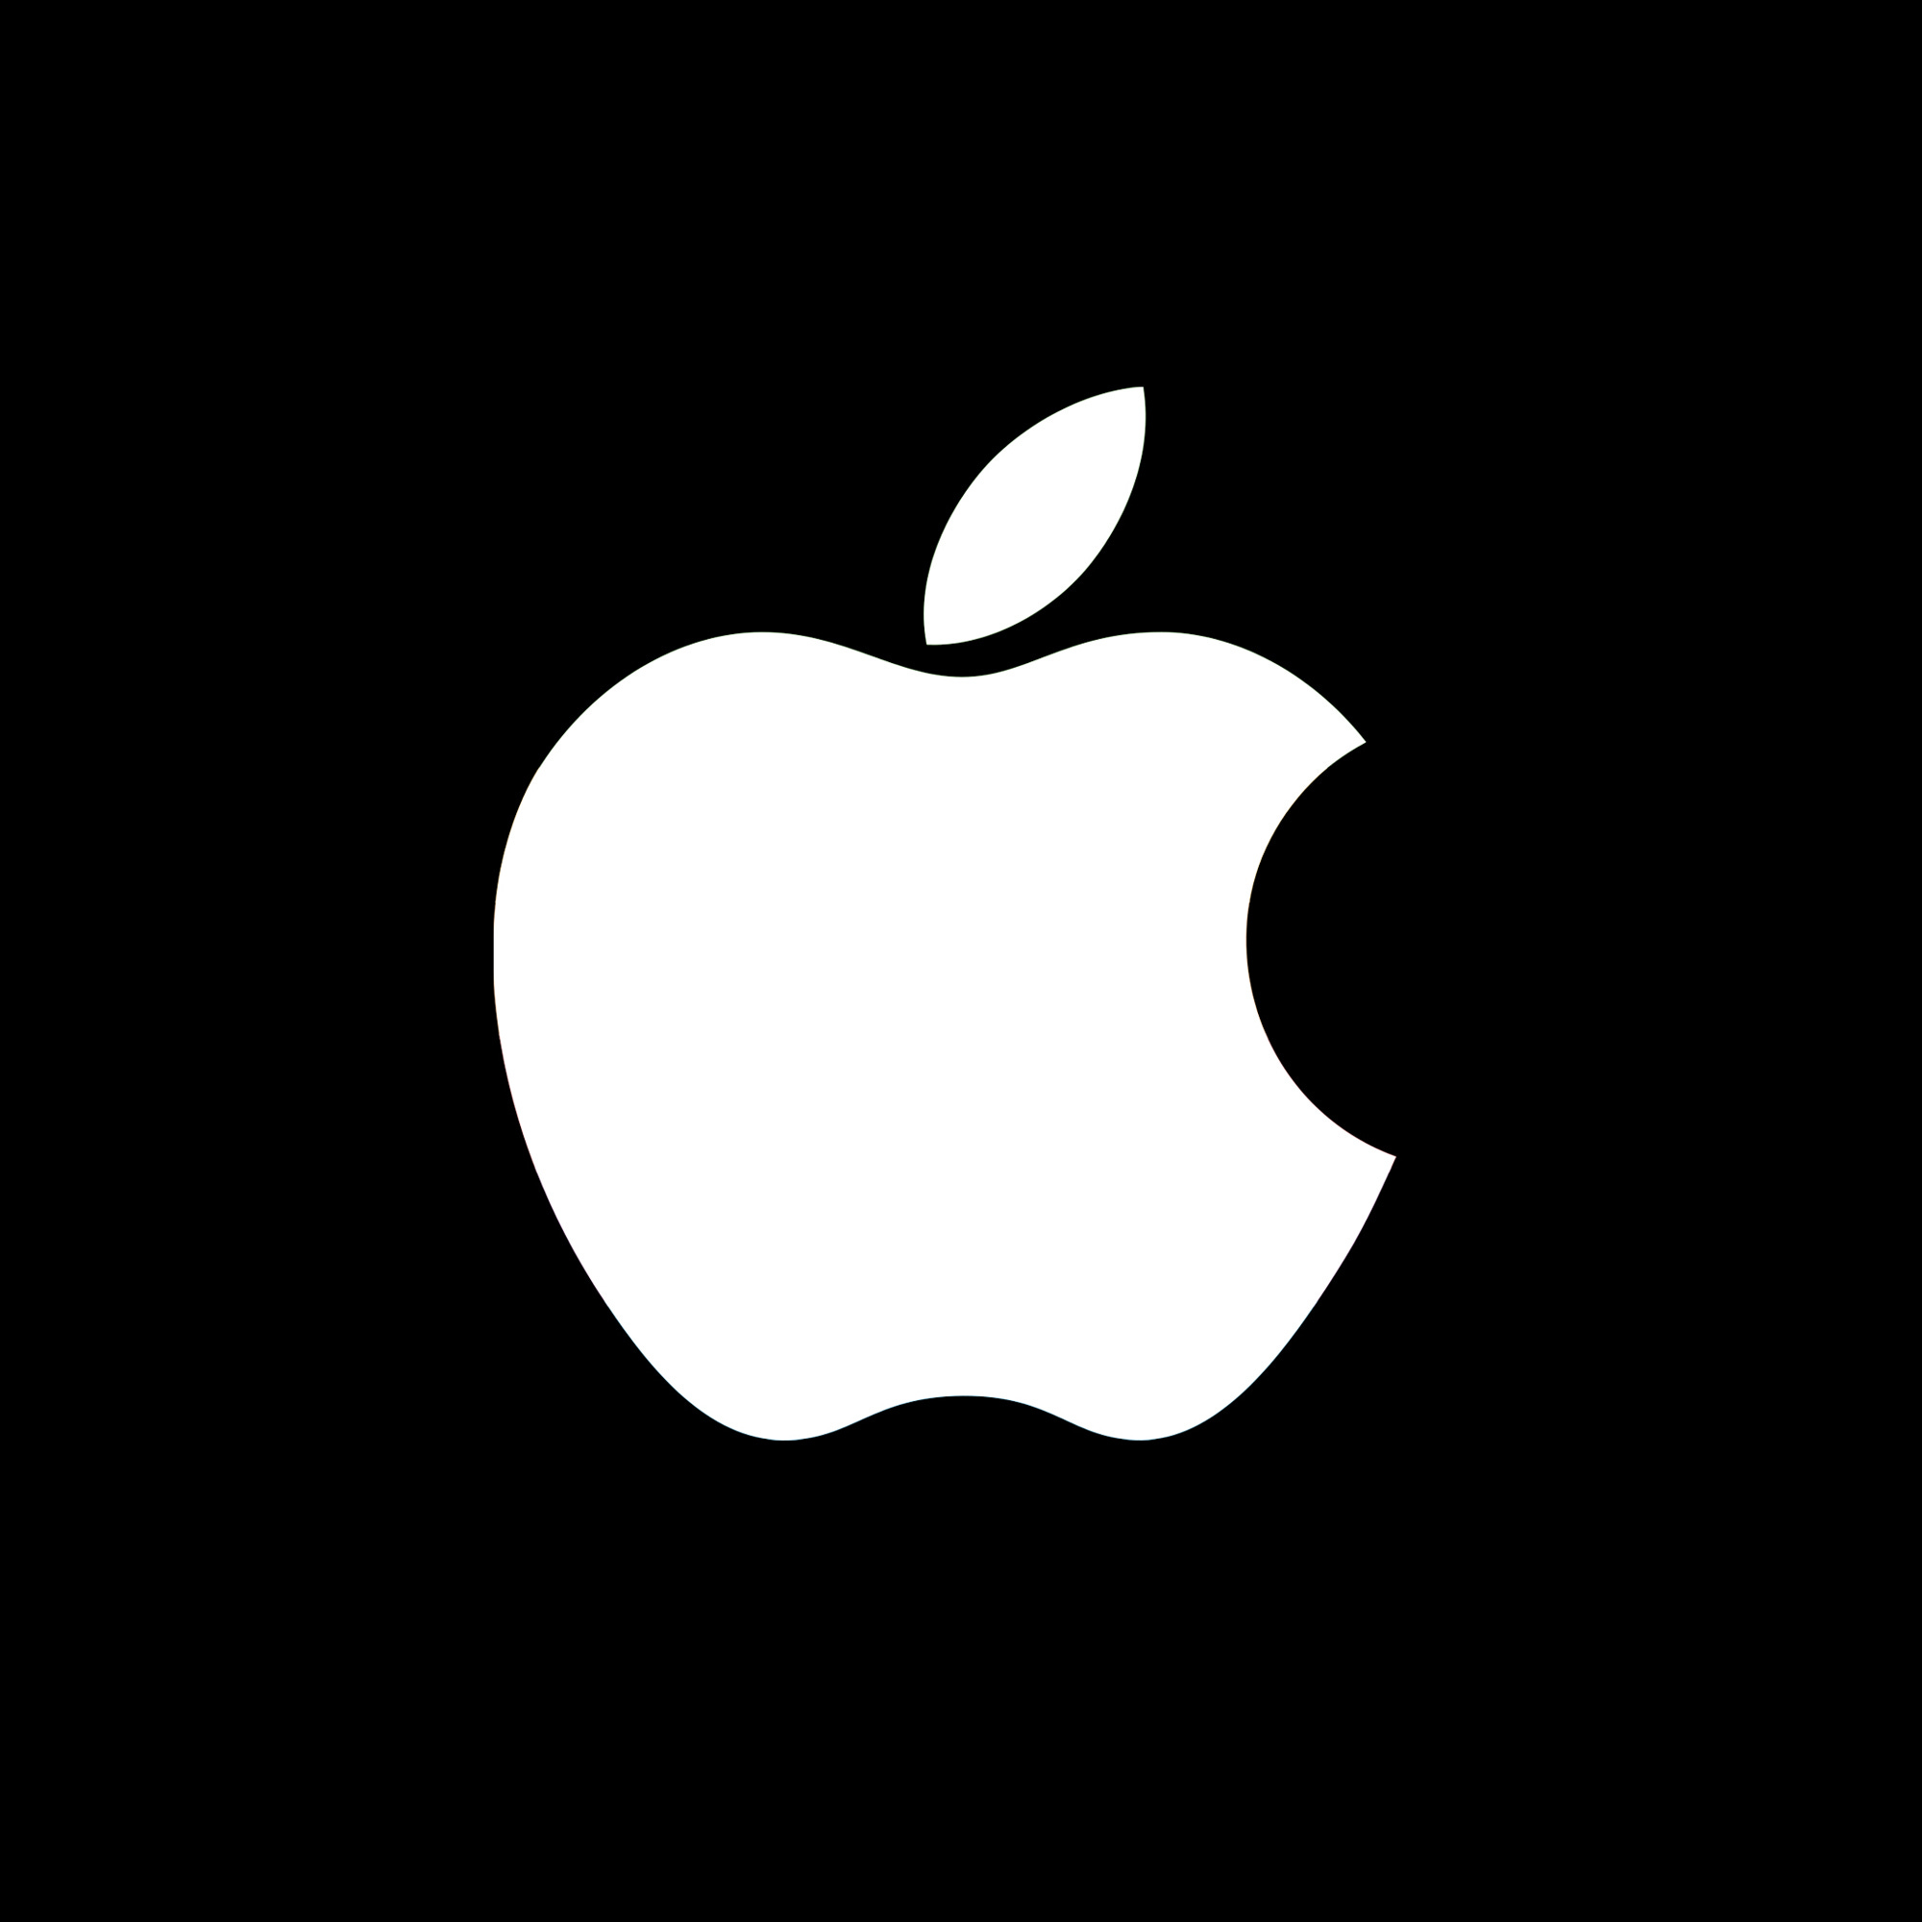
WHICH OPERATING SYSTEM
SHOULD PEOPLE CHOOSE ?
ANDROID
IOS

Slide 4
OBJECTIVES
Can we predict the operating system (iOS or Android) based on user behavior data?
What are the distinguishing characteristics of users who prefer iOS versus Android?
How does battery drain compare between iOS and Android devices on average?

Slide 5
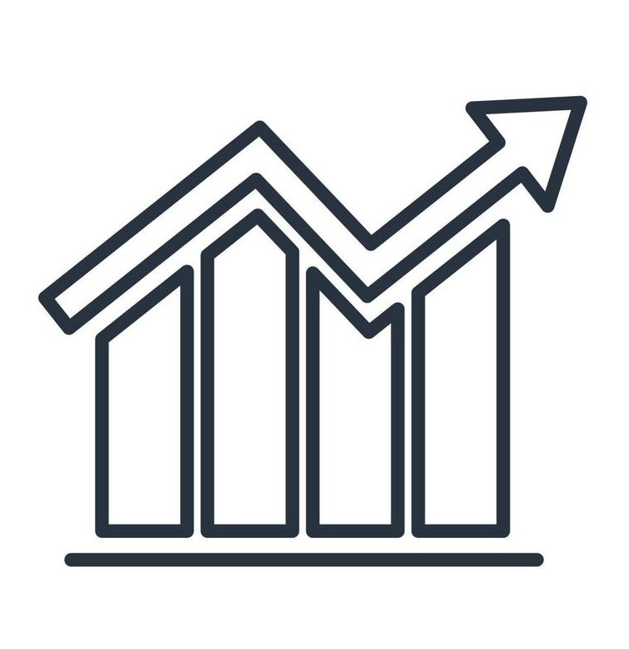


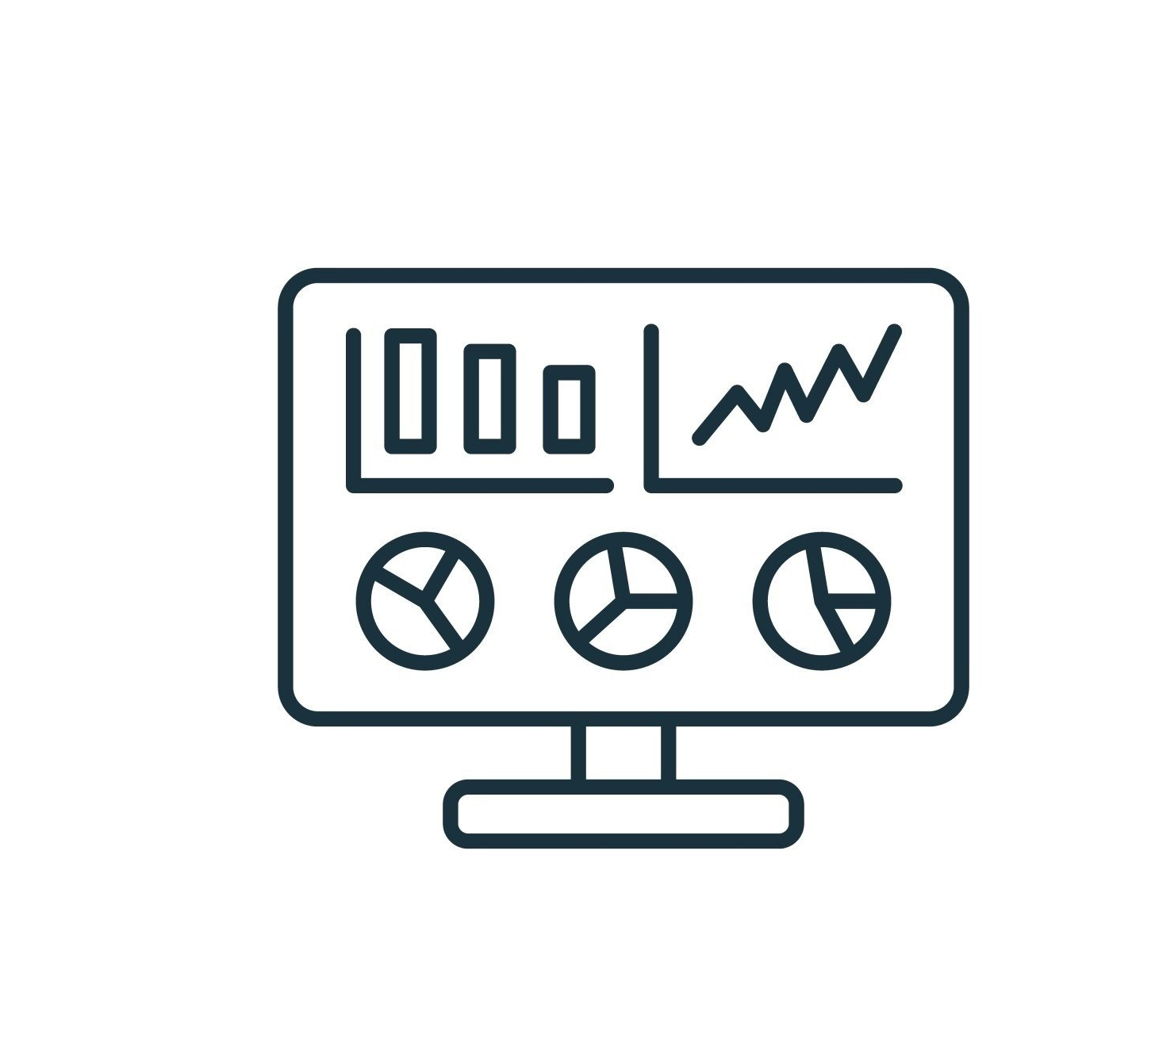
3
4
2
in 4 steps
1
Building the predictive model
Exploratory Analysis
Data Cleaning
Predictive model
Data Visualisation

Slide 6
1
2
3
4
Data Cleaning
Exploratory Analysis
Predictive model
Data Visualisation

Slide 7
3
4
2
1
Verified for duplicates
Standardized data formats for consistency
Data is ready for exploration
Looked for missing values
Predictive model
Exploratory Analysis
Data Visualisation
Data Cleaning

Slide 8
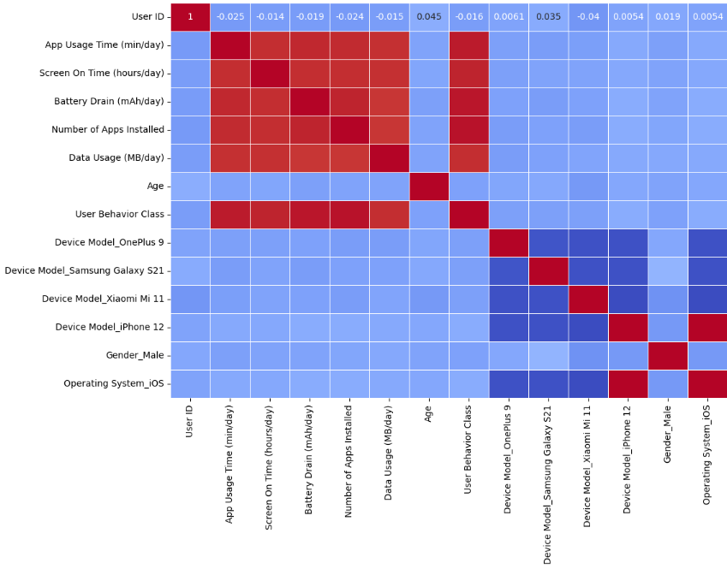
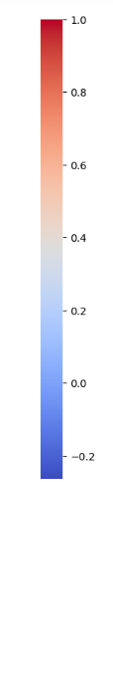
3
2
4
Analysis
Conducted a comprehensive exploration and visualization of the dataset.
Examined key charts to assess data distribution and trends.
Evaluated the sample's representativeness in relation to the overall population..
Performed between various features and operating system IOS to identify significant relationships.
Questions for correlation analysis :
What are the strongest correlations in this dataset?
Is there a significant correlation between Operating system and user behavior class ?
Do data usage and screen-on time correlate strongly, and if so, what does this indicate about usage habits?
Exploratory Analysis
Predictive model
Data Visualisatio

Slide 9
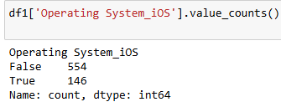

3
Clean data for model:
Removed unnecessary columns such as User ID that is unique and Device Model Iphone 12 since it is 100% correlated to the Operating system.
Tested models:
This is a classification model: since the results are only between IOS and Android. Therefore , we employed multiple corresponding modeling techniques, including Logistic Regression and Random Forest Classifier.
To enhance prediction accuracy, the SMOTE method was applied to balance the dataset, addressing the significant imbalance with approximately 75% of entries representing Android phones.
Concluded that the best model is Logistic Regression with an accuracy of 81% and a better precision score.
4
Data Visualisatio
Predictive model

Slide 10
4
Let’s see the Tableau Dashboard
Data Visualisation

Slide 11
CONCLUSIONS
Can we predict the operating system (iOS or Android) based on user behavior data?
Our predictive model is able to relatively accurately predict the operating system however a more balanced data set between IoS and Android Models would be better.
What are the distinguishing characteristics of users who prefer iOS versus Android?
There are none according to our correlation matrix.
How does battery drain compare between iOS and Android devices on average?
- iOS appears to be more efficient in maintaining consistent data usage relative to battery consumption compared to Android, which exhibits greater variability.
- Android may have specific scenarios (e.g., certain apps or system functions) that cause high data usage during peak battery consumption, suggesting room for optimization.

Slide 12


THANK YOU FOR YOUR ATTENTION

